Slide 1
Online Ticket Booking
Anil Kapoor

Slide 2

Online Ticketing
A comprehensive overview of the solution for XYZ Company's online movie ticket booking platform.
Project Vision: Deliver a seamless digital ticket booking experience that enhances customer satisfaction and drives increased ticket sales.
User Convenience: Provides 24/7 access for users, enabling them to book movie tickets anytime, anywhere with ease.
Operational Efficiency: Streamlines theatre operations by automating ticket booking and integrating with existing infrastructure.
Modern Moviegoing: Transforms the traditional cinema experience into a modern, tech-driven journey for the user.
Photo by Lloyd Dirks on Unsplash
Notes:
This platform does more than just sell tickets; it streamlines the entire booking operation for theatres. It eliminates long queues, reduces human error, and provides real-time updates on seat availability. For users, the convenience of 24/7 access through web and mobile apps modernizes the entire experience, turning it into an effortless process.
By adopting this digital-first approach, XYZ Company positions itself at the forefront of theatre innovation. The focus on user-friendly design, robust performance, and continuous availability ensures the platform is more than a utility—it becomes an integral part of the modern movie experience.

Slide 3
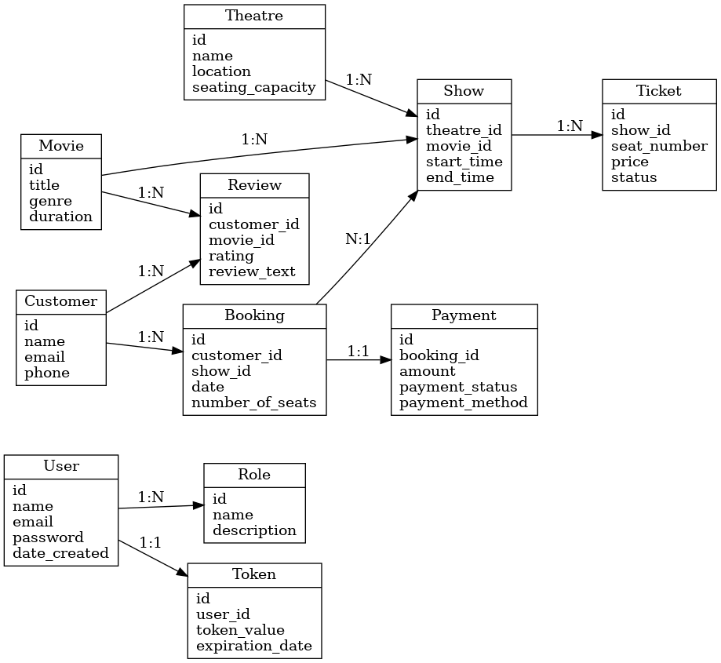
Derived Entities & ERD

Slide 4
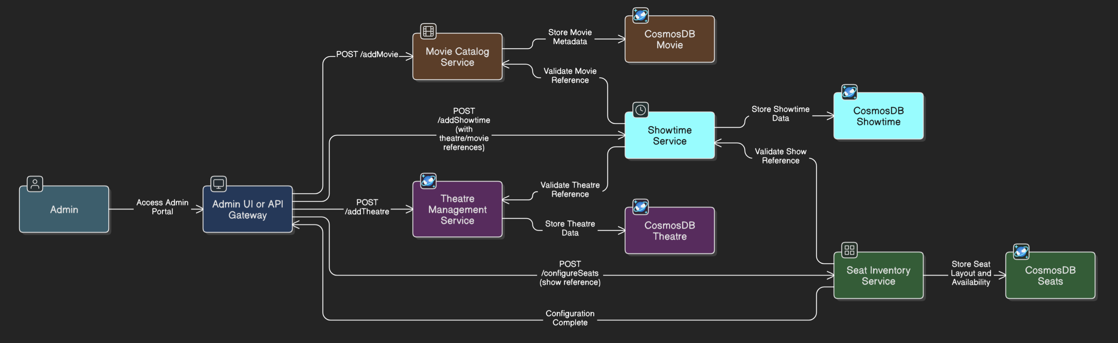
Admin Flow - Theatre/Ticket Management

Slide 5
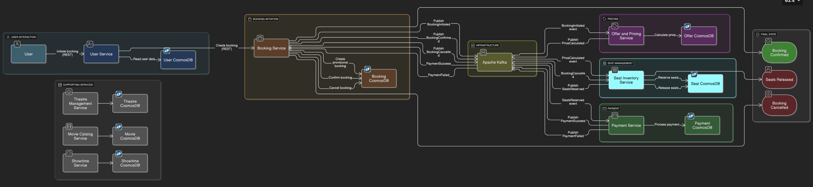
User Flow - Ticket Booking

Slide 6
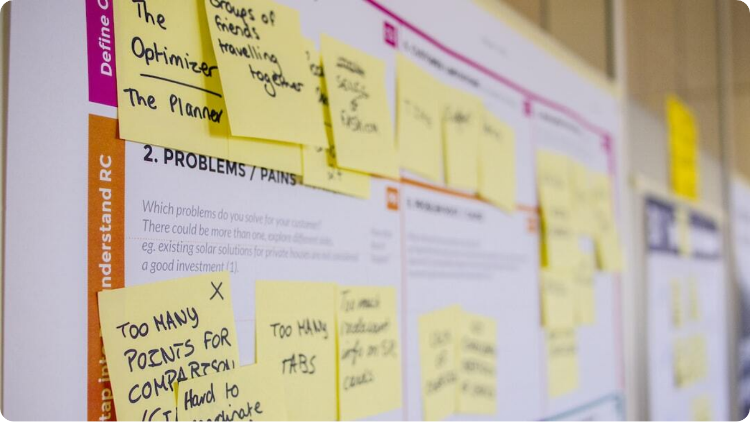
Project Planning & Timeline
Phased approach and execution timeline for XYZ Company's ticketing platform MVP.
Two-Phase Approach: Phase 1 delivered a MVP in 1 month; Phase 2 will focus on scaling and added features.
1-Month MVP Timeline: Week 1: Requirements. Week 2: Design. Week 3: Development. Week 4: Testing & Deployment.
Agile Coordination: Parallel task execution and Gantt chart visualized dependencies to optimize timeline.
Critical Path Management: Key tasks like infrastructure setup prioritized to unblock dependent activities.
Photo by Daria Nepriakhina 🇺🇦 on Unsplash
Notes:
The planning and execution of XYZ Company's ticketing platform followed a structured two-phase strategy. Phase 1 focused on developing a proof-of-concept within a tight one-month window, while Phase 2 will expand the feature set and scale operations.
Each week in Phase 1 had a dedicated focus—starting with requirements gathering, moving through architecture design and prototyping, into core development, and concluding with testing and deployment. This structure ensured all key milestones were addressed sequentially, with some parallelization where feasible.

Slide 7
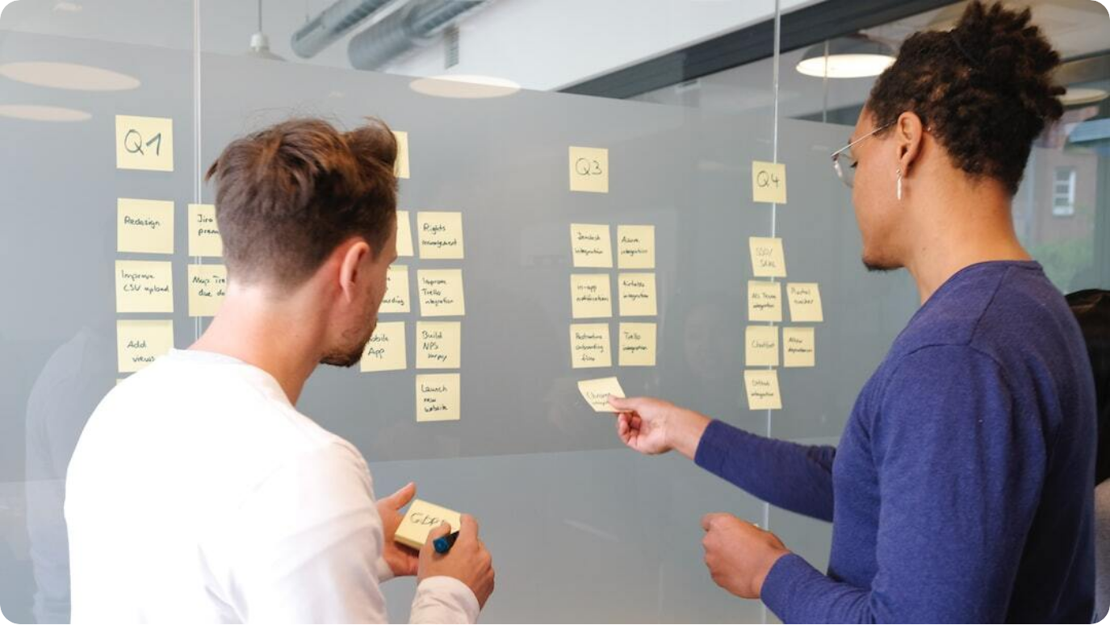
Resourcing & Team
Cross-functional team setup and agile collaboration model.
Cross-Functional Team: Team of 5 with roles spanning architecture, management, development, and DevOps.
Technical Leadership: Solution Architect and Project Manager co-led direction and execution.
Collaborative Development: Developers worked closely with architect for reviews and integrations.
Agile Practices: Daily stand-ups, demos, and continuous delivery ensured rapid progress.
Photo by airfocus on Unsplash
Notes:
The success of the MVP phase was significantly driven by the team’s composition and its collaborative workflow. XYZ Company assembled a cross-functional team with clearly defined roles, ensuring every technical and operational aspect was covered.
Leading the effort were the Solution Architect and the Project Manager, who jointly steered the technical strategy and project coordination. Developers worked hand-in-hand with the architect, ensuring implementations matched design intentions and were aligned with project goals. Meanwhile, the DevOps engineer played a vital role from day one, setting up pipelines and infrastructure that enabled rapid iterations.
Adopting agile methodologies, the team held daily stand-ups and weekly demos. This iterative, feedback-driven approach allowed for quick adjustments and maintained strong alignment across stakeholders. The synergy among roles ensured that architecture, development, and deployment remained in lockstep—critical for meeting the tight MVP timeline.

Slide 8

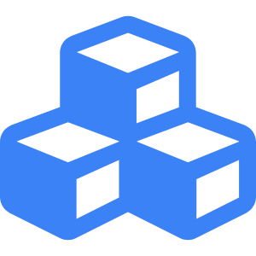


Architecture Overview
Technical foundation of XYZ Company’s online ticketing platform.
API Gateway
Central entry point handling routing, authentication, and rate limiting for all client requests.
Microservices on AKS
Lightweight Spring Boot services containerized with Docker and deployed on Azure Kubernetes Service.
Cosmos DB
Globally distributed NoSQL database ensuring high availability and low latency for user and booking data.
Confluent Kafka
Event-driven messaging backbone enabling asynchronous communication and decoupling of services.
Notes:
At the core of XYZ Company’s ticketing platform lies a cloud-native, microservices-based architecture. The design is focused on scalability, resilience, and efficient handling of both real-time and asynchronous workflows.
Client applications—whether web or mobile—interact with the system via a centralized API Gateway. This component not only routes requests but also manages security features such as authentication, SSL termination, and request throttling. Behind the gateway lies a suite of Spring Boot microservices, each designed to handle a distinct piece of business logic. These services are deployed on Azure Kubernetes Service (AKS), ensuring high availability and scalability.
For persistent data storage, Azure Cosmos DB offers a distributed NoSQL solution that supports global replication and scales elastically with demand. Finally, the architecture leverages Kafka for inter-service communication. Kafka acts as a decoupled, fault-tolerant messaging layer that enables asynchronous event processing—critical for workflows like booking confirmations and notifications. Together, these components create a robust and responsive system foundation.

Slide 9
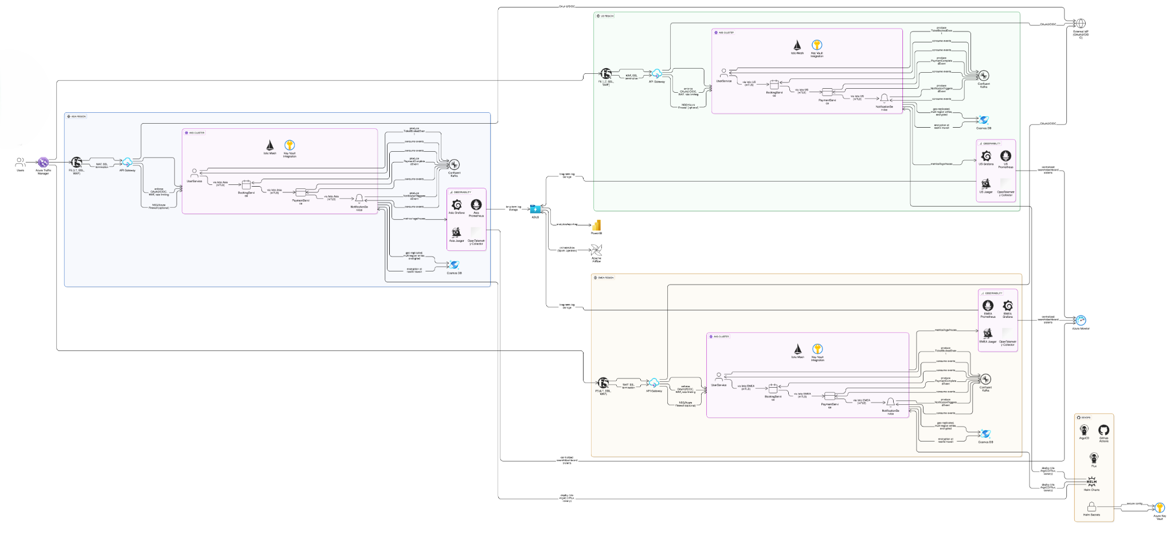
Architecture - Platform Infra
Technical foundation of XYZ Company’s online ticketing platform.

Slide 10




Microservices Functionality & Flow
Integration of synchronous REST and asynchronous messaging.
Synchronous REST Calls
Real-time client requests are handled via REST APIs through the API Gateway and between services.
Asynchronous Messaging
Kafka enables non-blocking event-driven workflows such as booking confirmations and notifications.
Hybrid Communication Model
Combines REST for immediacy and Kafka for decoupled background processing, optimizing responsiveness.
Resiliency and Decoupling
Kafka ensures services remain responsive even if downstream consumers are temporarily offline.
Notes:
The ticketing platform’s communication model smartly integrates both synchronous and asynchronous patterns to balance responsiveness and decoupling.
Synchronous REST APIs are used for real-time operations that require immediate feedback—such as user authentication or seat availability checks. These calls are routed through the API Gateway and, in some cases, services make internal HTTP calls to other services.
For background processes, the architecture relies on Apache Kafka. When a booking is confirmed, for instance, the Booking Service emits a 'BookingConfirmed' event to Kafka. Other services like Notifications and Analytics subscribe to this event and process their respective actions independently. This approach avoids delaying the original request-response cycle.
This hybrid model provides agility and robustness. It allows the system to handle spikes in traffic gracefully and ensures that even if one part of the system is temporarily offline, operations continue without user disruption. This results in a highly resilient and scalable microservices ecosystem.

Slide 11



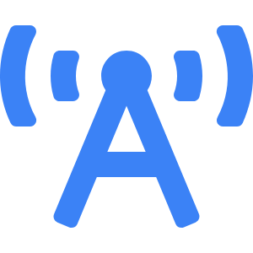

Technologies Used
Full technology stack supporting XYZ Company’s ticketing solution.
Java & Spring Boot
Robust microservices built using Java and Spring Boot for rapid development and reliable APIs.
Docker & Kubernetes
Microservices containerized with Docker and orchestrated on Azure Kubernetes Service for scalability.
Azure Cloud Services
Leveraged Azure for AKS, Cosmos DB, networking, monitoring, and identity integration.
Apache Kafka
High-throughput event streaming platform for decoupled, resilient communication.
Observability
Azure Monitor, Prometheus, Jaegar and Grafana for logging, tracing, and real-time metrics across microservices.
DevOps CI/CD
Github Actions for continuous integration, automated testing. ArgoCD, Flux & Helm Charts for continuous deployments.
Notes:
The XYZ ticketing platform is built using a modern cloud-native technology stack that ensures scalability, resilience, and fast development cycles. At the core is Java, paired with the Spring Boot framework, which enables efficient creation of RESTful services and simplifies microservice development with embedded server support and preconfigured modules.
Each microservice is packaged using Docker, which provides consistency across environments, and deployed via Azure Kubernetes Service. AKS handles orchestration—managing deployment, scaling, and recovery seamlessly. On the infrastructure side, Microsoft Azure offers a robust set of managed services including Cosmos DB for globally distributed data, Azure Monitor for logging and observability, and Azure AD for secure identity management.
To support asynchronous communication and event processing, Kafka serves as the message broker. It allows services to publish and consume events reliably and at scale, enhancing the system’s responsiveness and resilience. This curated combination of technologies ensures that the platform is maintainable, high-performing, and ready for rapid iteration.

Slide 12



Challenges & Solutions
Key hurdles and strategies implemented in the PoC phase.
Scaling Peak Load
Used Kubernetes autoscaling and Azure load balancers to handle high demand during surges.
Data Consistency
Applied eventual consistency, idempotent operations, and Kafka event sequencing to ensure integrity.
Failure Recovery
Built-in retries and compensation logic enabled graceful handling of partial failures.
Efficient Resource Use
Autoscaling minimized costs while maintaining performance using demand-based provisioning.
Notes:
Every technology project faces its set of challenges, and XYZ’s online ticketing PoC was no exception. A primary concern was ensuring system scalability during traffic spikes, such as new movie releases or promotions. To address this, Kubernetes’ Horizontal Pod Autoscaler and Azure’s Application Gateway were employed to dynamically adjust resources based on real-time metrics.
Data consistency in a distributed microservices architecture is another classic hurdle. The team tackled this using idempotent consumer logic, eventual consistency, and Kafka’s ordered event processing. This ensured reliable outcomes even in the face of retries or partial failures.
Moreover, system resilience was strengthened through retry logic and compensation mechanisms—allowing the system to recover gracefully from transient issues. These patterns were essential for maintaining service integrity without frustrating users.
Finally, autoscaling strategies not only handled peak traffic efficiently but also optimized operational costs by releasing unused resources during off-peak hours. Together, these technical solutions created a robust and economical platform foundation.

Slide 13

Future Plans & Scalability
Roadmap for expansion and platform optimization.
Event Ticketing Expansion: Platform to be extended to concerts, sports, and other live events.
AI Recommendation Engine: Planned integration of ML-based suggestions for personalized user experiences.
Cloud Optimization: Multi-region deployments, auto-scaling, and cost management enhancements planned.
Scale Readiness: System tested and designed to support 10x user growth with load testing and chaos engineering.
Photo by Gian-Reto Tarnutzer on Unsplash
Notes:
XYZ Company has set a clear and ambitious roadmap for the online ticketing platform, building on the solid foundation established in the PoC. One of the first expansion targets is to extend the platform beyond cinema to include events like concerts and sports. This horizontal scaling will open new markets and revenue streams.
To enrich user experience and engagement, the integration of an AI-powered recommendation engine is underway. By analyzing user behavior and past bookings, the system will suggest relevant content, increasing conversion rates and user satisfaction.
Infrastructure-wise, the team plans to optimize for scale by deploying in multiple Azure regions, tuning autoscaling policies, and leveraging cost-saving strategies such as scaling down to zero and reserved instances. These changes aim to maximize both performance and operational efficiency.
Additionally, ongoing load testing and chaos engineering are integral to ensure the system can withstand significant user growth—up to 10 times the current load—without performance loss. These proactive steps position the platform to scale smoothly and meet growing user demands.

Slide 14




Conclusion & Next Steps
Summary of achievements and roadmap beyond MVP.
MVP Success
Platform validated core functionality—ticket search, seat selection, and payments delivered in one month.
Lessons Learned
Microservices and DevOps strategy proved effective; observability and feedback loops were essential.
Next Phase Objectives
Production hardening, new feature rollouts (events, recommendations), and user onboarding planned.
Scale & Feedback
Scaling infrastructure, onboarding more users, and iterating based on user feedback prioritized.
Notes:
The initial phase of XYZ Company's online ticketing platform marks a clear success. Within just one month, the team delivered a fully functional proof-of-concept demonstrating the core use cases—searching for movies, reserving seats, and processing payments—all via a robust microservices-based cloud architecture.
From this process, several key lessons were extracted. The microservices model offered clear benefits in terms of flexibility and scaling, while the DevOps-first approach ensured deployments were fast and predictable. Observability tools played a crucial role in debugging and monitoring the system, underlining the need for integrated logs and metrics in distributed environments.
Looking ahead, the focus will shift to refining the platform for full production deployment. This includes implementing comprehensive testing, enhancing security, and deploying new features such as multi-event ticketing and AI-driven recommendations. User onboarding will scale gradually, leveraging autoscaling capabilities to ensure performance under increasing load.
Regular user feedback cycles will guide the refinement of UI/UX and help steer the platform toward becoming a flagship digital product for XYZ Company.

